Slide 1
Slide 16
Graphical Widget
Dasar-Dasar Pemrograman 1
Semester Ganjil 2016/2017

Slide 2
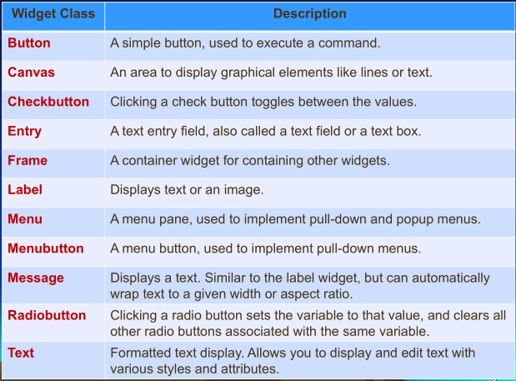
Tkinter widget classes
Dasar-Dasar Pemrograman Ganjil 2016-2017

Slide 3


Label
Syntax:
  variable = Label( master, option, ... )
Example:
Output:
Dasar-Dasar Pemrograman Ganjil 2016-2017

Slide 4
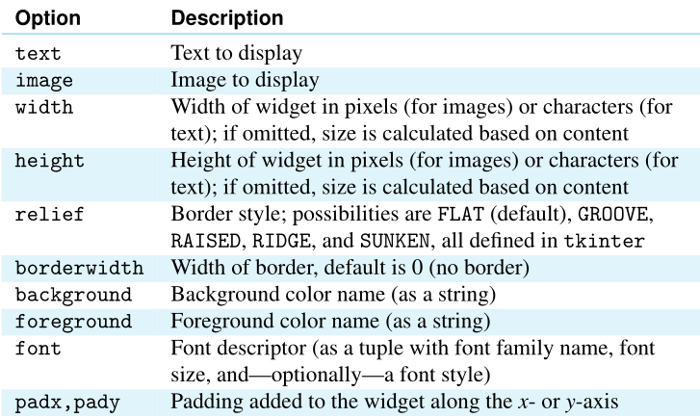
Label option properties
Dasar-Dasar Pemrograman Ganjil 2016-2017

Slide 5
Displaying image
A Label widget can be used to display more than just text, it can be used to display image too
The image should be opened first with PhotoImage class
Basic syntax to open an image:
  variable = PhotoImage(file=‘<image file>’)
Example:
  image = PhotoImage(image=‘peace.png’)
Fill image parameter to include the image to the Label
Dasar-Dasar Pemrograman Ganjil 2016-2017

Slide 6
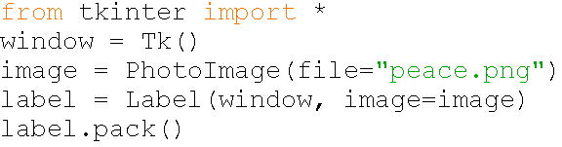
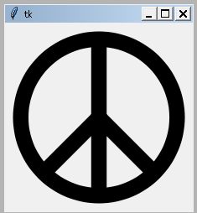
Example
Output:
Dasar-Dasar Pemrograman Ganjil 2016-2017

Slide 7
Packing widget
The tkinter geometry manager is responsible for the placement of widgets within their master
The method pack() is one of the methods that can be used to place the widget within its master
Example:
  label.pack()
You can also set the placement location by filling side parameter
Dasar-Dasar Pemrograman Ganjil 2016-2017

Slide 8
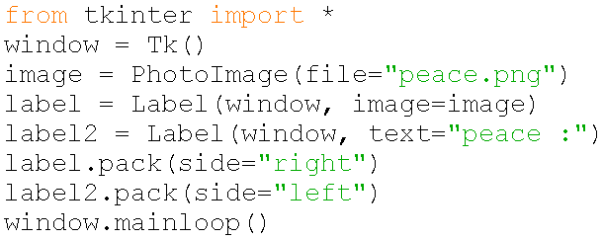
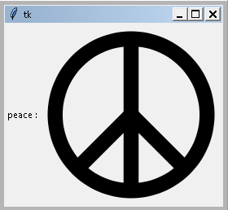
Example
Output:
Dasar-Dasar Pemrograman Ganjil 2016-2017

Slide 9
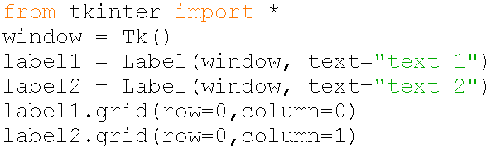

Packing widget
If we need to place several widgets in a gridlike fashion, we can use method grid() to pack the widget
Basic syntax:
  widget.grid(row=<row number>, column=<column number>)
Example:
Dasar-Dasar Pemrograman Ganjil 2016-2017

Slide 10
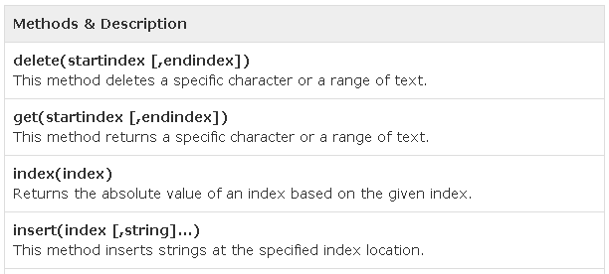
Text widget
Text widgets provide advanced capabilities that allow you to edit a multiline text and format the way it has to be displayed, such as changing its color and font
Syntax:
  variable = Text ( master, option, ... )
Widget’s method:
Dasar-Dasar Pemrograman Ganjil 2016-2017

Slide 11
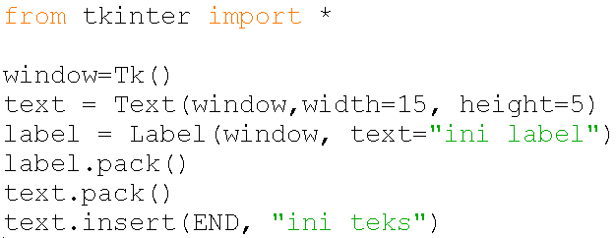
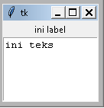
Example
Dasar-Dasar Pemrograman Ganjil 2016-2017

Slide 12
Color
To specify a color, use either a color name (such as red, yellow, green, blue, white, black, purple) or explicitly specify the red, green, and blue (RGB) color components by using a string #RRGGBB
In #RRGGBB; RR, GG, and BB are hexadecimal representations of the red, green, and blue value respectively
Dasar-Dasar Pemrograman Ganjil 2016-2017

Slide 13
Font
You can specify a font in a string that includes the font name, size, and style
Examples:
  Times 10 bold
  Helvetica 10 bold italic
  CourierNew 20 bold italic
  Courier 20 bold italic underline
Dasar-Dasar Pemrograman Ganjil 2016-2017

Slide 14
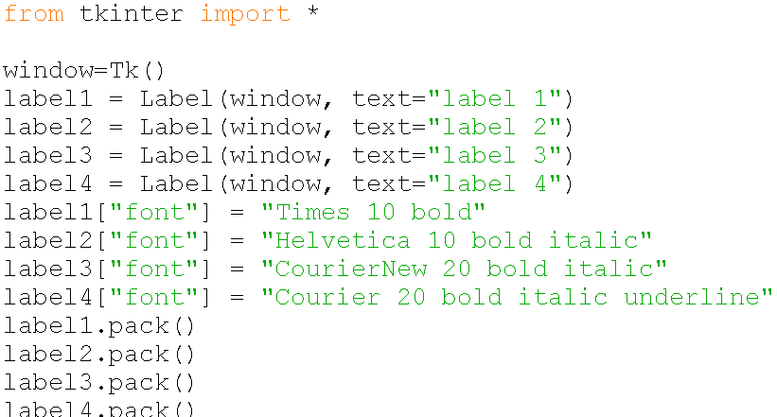
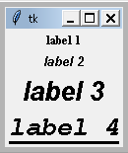
Example
Dasar-Dasar Pemrograman Ganjil 2016-2017

Slide 15
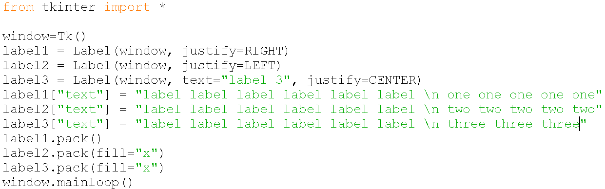
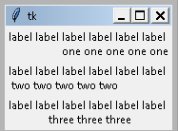
Text Formatting/Alignment
You can change the alignment of text by using the justify option with the named constants LEFT, CENTER, or RIGHT
Example
Dasar-Dasar Pemrograman Ganjil 2016-2017

Slide 16
Event-Based Widget
Some widgets have an interactive behavior that needs to be programmed using a style of programming called event-driven programming
Event-driven programming is also used in the development of computer games and distributed client/server applications, among others
Dasar-Dasar Pemrograman Ganjil 2016-2017

Slide 17


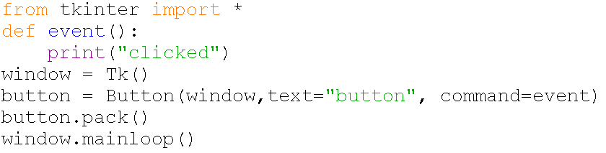
Button Widget
The class Button from module tkinter represents GUI buttons
Syntax:
  w = Button ( master, option=value, ... )
Example:
Dasar-Dasar Pemrograman Ganjil 2016-2017

Slide 18
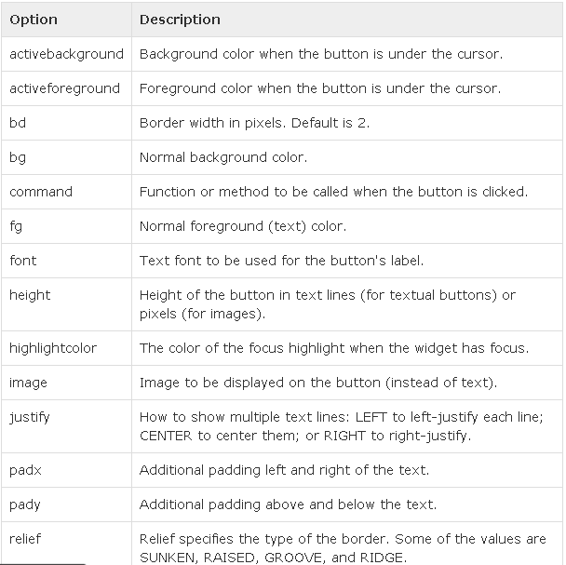
Button option properties
Dasar-Dasar Pemrograman Ganjil 2016-2017

Slide 19
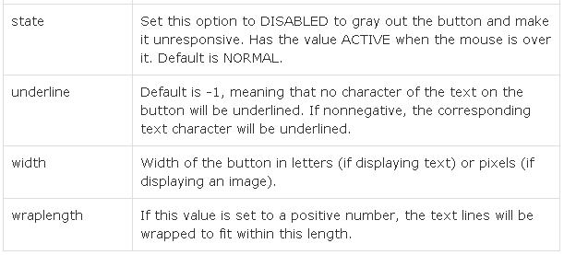
Button option properties (cont.)
Dasar-Dasar Pemrograman Ganjil 2016-2017

Slide 20
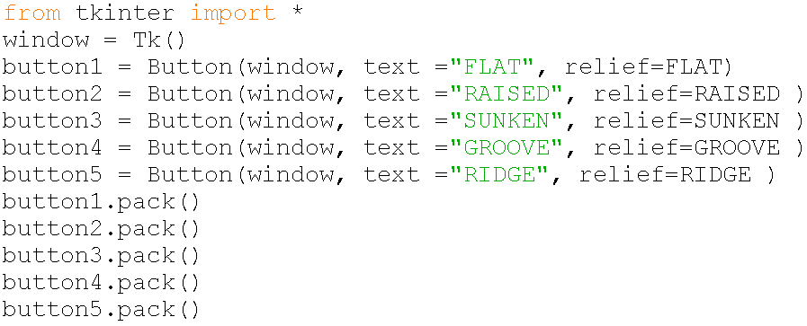
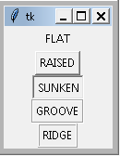
Button property: relief
The relief style of a widget refers to certain simulated 3-D effects around the outside of the widget
Dasar-Dasar Pemrograman Ganjil 2016-2017

Slide 21
Entry widget
Entry widget represents the classic single-line text box you would find in a form
Syntax:
  variable = Entry( master, option, ... )
Entry widget has get method to grab the widget value
Dasar-Dasar Pemrograman Ganjil 2016-2017

Slide 22
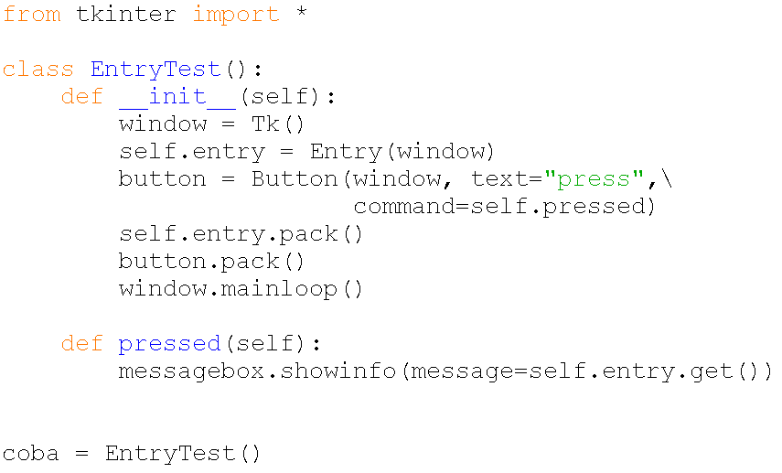
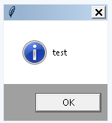

Example
Dasar-Dasar Pemrograman Ganjil 2016-2017

Slide 23
Frame widget
The Frame widget is very important for the process of grouping and organizing other widgets in a somehow friendly way
Syntax:
  variable = Frame ( master, option, ... )
Dasar-Dasar Pemrograman Ganjil 2016-2017

Slide 24
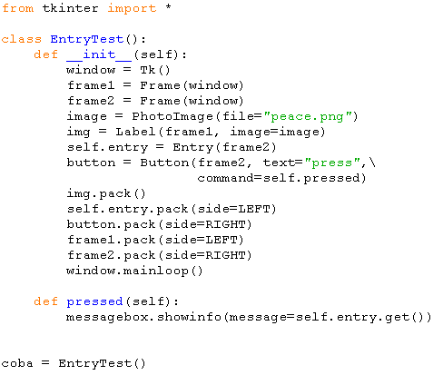
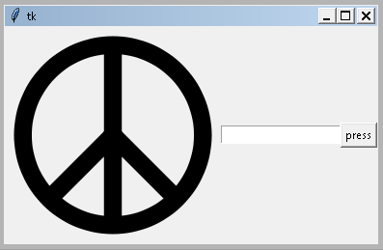
Example
Dasar-Dasar Pemrograman Ganjil 2016-2017

Slide 25
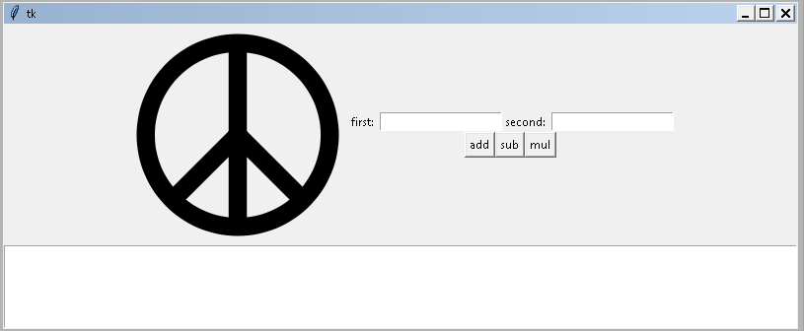
Exercise
Create a simple calculator that can calculate addition, subtraction, and multiplication such as:
Dasar-Dasar Pemrograman Ganjil 2016-2017

Slide 26
References
William Punch & Richard Enbody. The Practice of Computing using Python, 2nd Edition. Addison-Wesley, 2013
Y. Daniel Liang. Introduction to Programming Using Python. Prentice Hall, 2013.
John Zelle. Python Programming: An Introduction to Computer Science, 2nd Edition. Franklin, Beedle & Associates Inc., 2010.
Mark Lutz. Learning Python, 5th Edition. O’Reilly Media. Copyright 2013 Mark Lutz, 978-1-44-93-5573-9
L. Y. Stefanus. Slide Pelatihan Python. 2015.
Dasar-Dasar Pemrograman Ganjil 2016-2017

